Slide 1

SkyInsight
A Weather Forecast and Analysis app
A course project under Prof. Dootika Vats

Slide 2

About
This app provides real time forecast and analysis of Various cities of India.
It also predicts the precipitation, air pressure and average temperature of that city upto a year

Slide 3









Interesting insights
In Chennai, precipitation peaks in mid-October while in Delhi it peaks in July.
In Guwahati, sun rises around 5:30 and in Mumbai, it happens around 6:45, though they both lie in same time zone

Slide 4

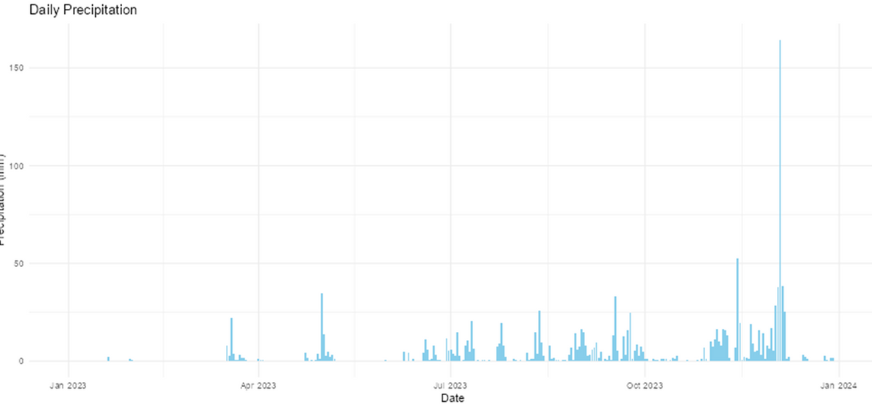
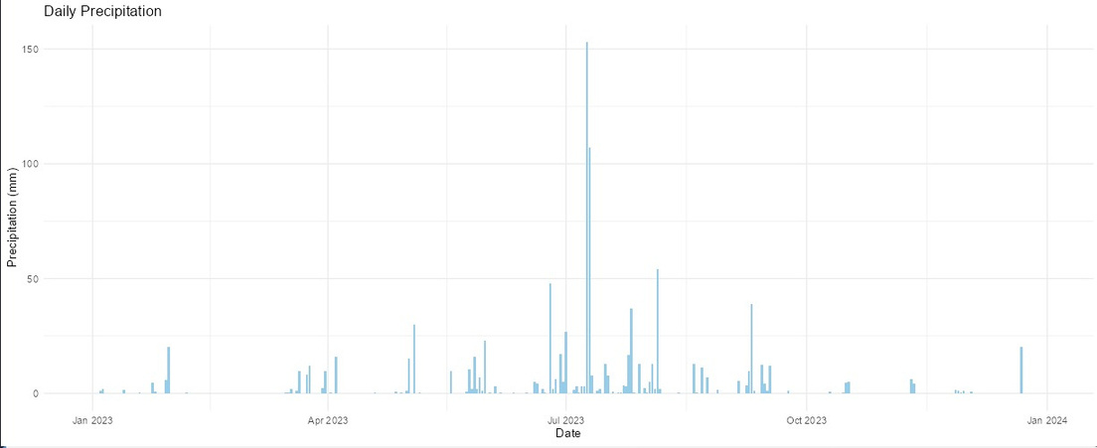
Visual Representation
Chennai
Delhi

Slide 5
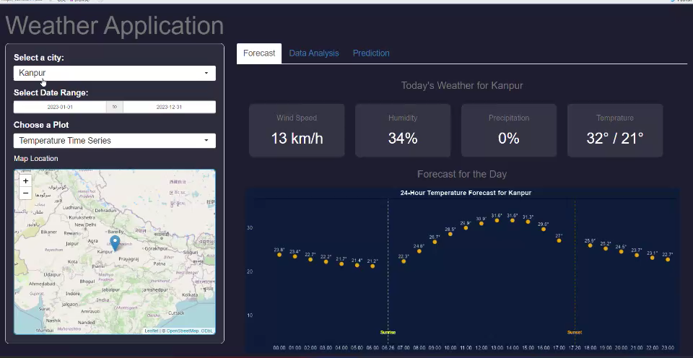
Detailed video of app

Slide 6
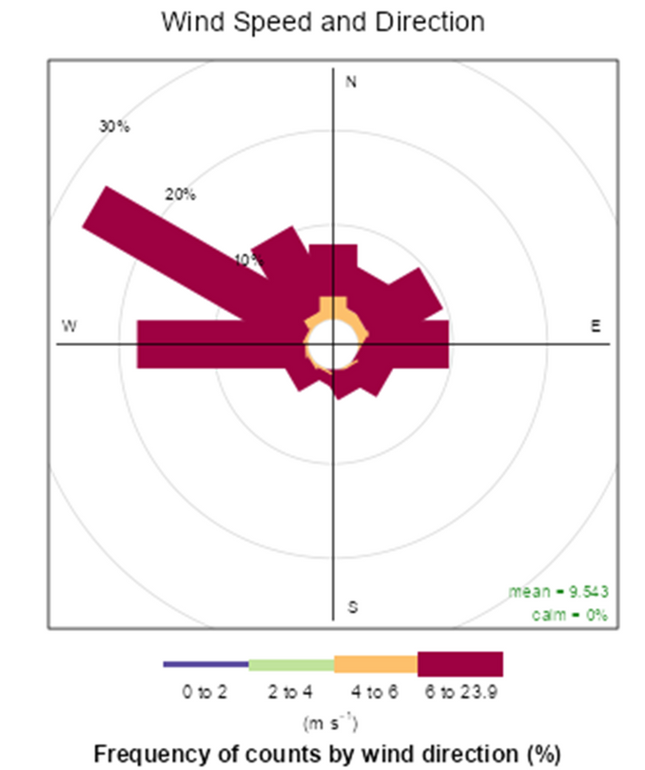
A wind rose plot
It reveals wind’s favorite directions and speeds, showing at a glance where the breeze—or a storm—might be coming from. Perfect for planning, predicting, and navigating the weather with ease.

Slide 7


Thanks!
Presented by Group 28
• Aditya N Singh
• Dhruv Shetty
• Jaykant Nayak
• Tapas Mandal

